Slide 1

LEADING THE FUTURE OF AGRICULTURE AND POWER IN AFRICA

Slide 2
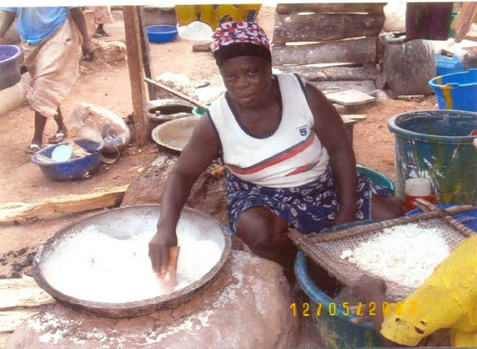
THE PROBLEM
USE OF CHEMICAL FERTILIZERS
HIGH COST OF PROCESSING CASSAVA
HEALTH RISKS
POWER SCARCITY
FOOD INSECURITY

Slide 3

THE SOLUTION
HEALTHY COOKING ALTERNATIVE
ECO-FRIENDLY
CHEAPER AND CLEANER ALTERNATIVE FOR GENERATING ELECTRICITY
PRODUCES BETTTER ALTERNATIVE TO CHEMCIAL FERTILIZERS
REDUCTION IN COST OF PROCESSING CASSAVA
INCREASE IN INCOME
INCREASE IN CROP PRODUCTION
FOOD SECURITY

Slide 4
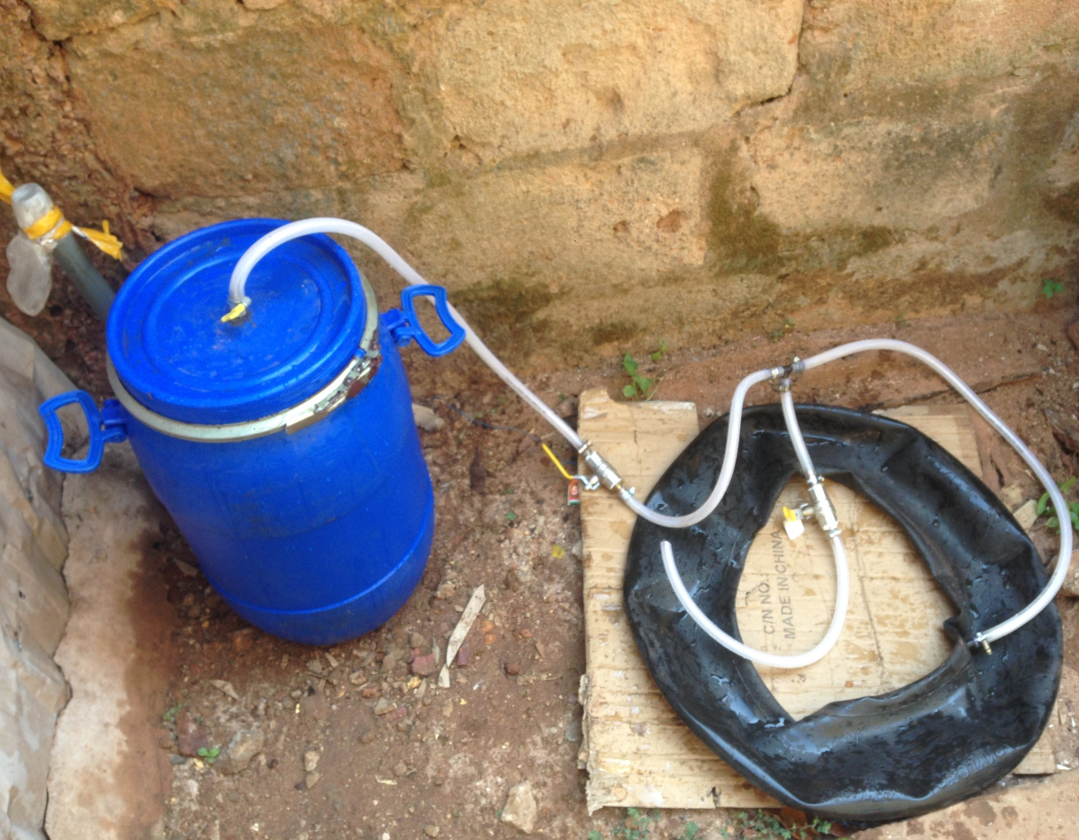
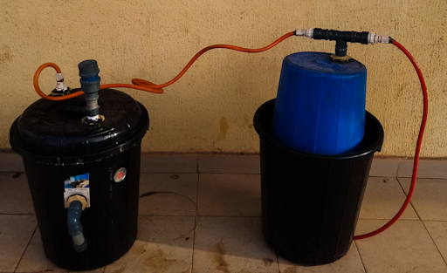
OUR PROTOTYPES (TACTION)
CURRENT PROTOTYPE
FIRST PROTOTYPE

Slide 5
OUR GROWTH
PHASE 3
PHASE 2
PHASE 1

Slide 6
PHASE 1(THE BEDROCK)
TOP GOALS OF THIS PHASE
MAJOR SIGNS OF IMPACTS
The launch of the trine ark our MVP. With other related products,
Use of our revenue model 0.1,
Gaining the truth of the public,
Securing of investments and partnerships.
QUALITY AND AFFORDABLE CASSAVA PRODUCTS
PUBLIC INTEREST IN THE MISSION
INCREASE IN CASSAVA PRODUTION

Slide 7
OUR REVENUE MODEL 0.1
Our subscription business model will generate revenue through the following streams:
Training and consultancy,
Sales of our trine ark, bio-fertilizer, biogas and ark catalyst,
Installation and maintenances services
All this for our target market which are cassava farmers, processers and household.

Slide 8
PHASE 2 (THE SOCIAL WALK)
TOP GOALS OF THIS PHASE
MAJOR SIGNS OF IMPACTS
GAINING MORE PARTNERS
More community outreaches and trainings,
The launch of our T-guide (a device that protects whatever it is placed around of and runs on biogas)
Connecting our farmers and crop processers to our partners in the agro-business sector.
MORE JOBS DUE TO OUR NICHE.
Increase in income of our clients
NEW BUSINESSES AND COMPETITION OPENED IN RELATION TO OUR CREATED NICHE.

Slide 9
WE ARE PARTNERING WITH BUSINESSES IN THE FOLLOWING SECTORS
TRINE TECH
LOGISTICS COMPANIES
POWER
FOOD EXPORT
NGO’S
FARMERS ASSOCIATIONS
STATE WASTE COMMISSIONS
ECOMMERCE COMPANIES
TRADE ASSOCIATIONS

Slide 10
PHASE 3(GOING BIG)
TOP GOALS OF THIS PHASE
MAJOR SIGNS OF IMPACTS
Construction and launch of our biogas-electro station
Creating an enabling environment for electro based businesses to set up through our niche
Distribution of the electricity with the aid of our partners,
Expanding the reach of our business,
HEALTHY AND CHEAPER FOOD
CLEANER, STABLE AND AFFORDABLE POWER SUPPLY,
Reduction in food wastage,
MORE JOBS

Slide 11
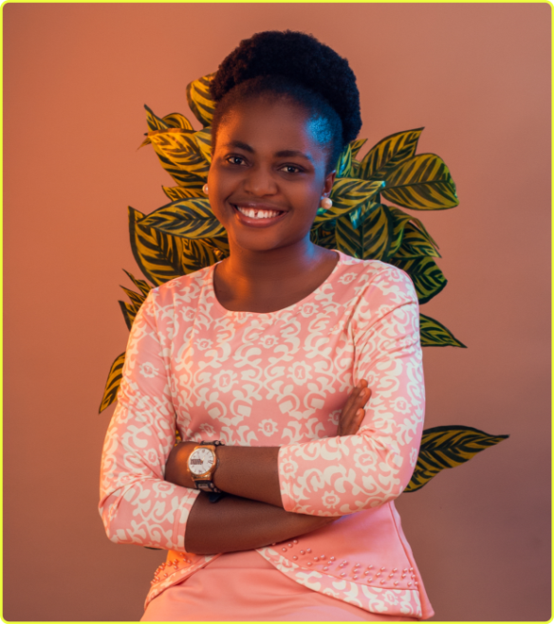
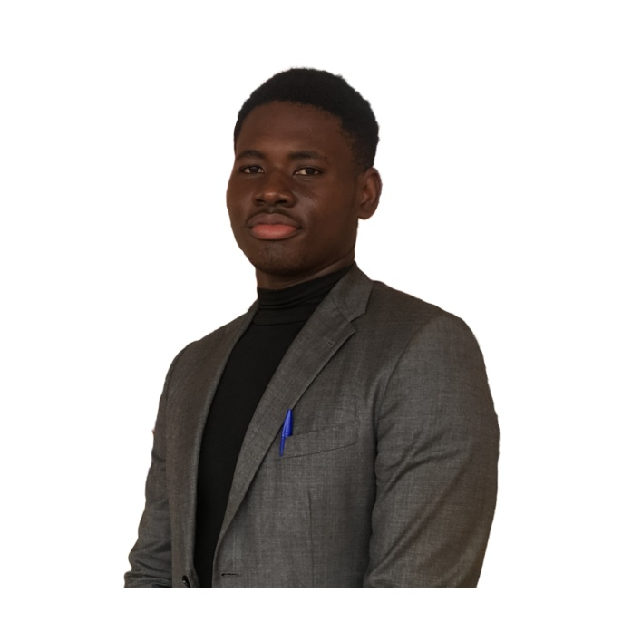
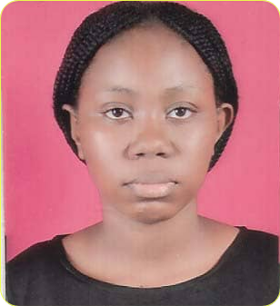
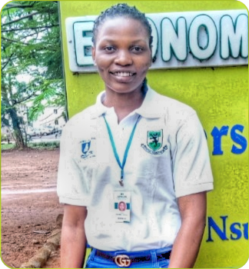
OUR TEAM
GLORY AMADIFE
CO-FOUNDER
MMERICHUKWU ANOSIKE
CO-FOUNDER
OLUCHI NKEONYE
RESEARCH AND MARKETING
JOY OGUMBA
GRAPHICS DESIGN AND VIDEO EDITING

Slide 12

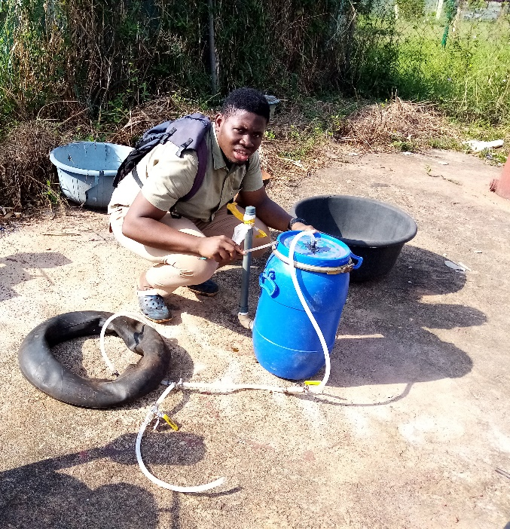
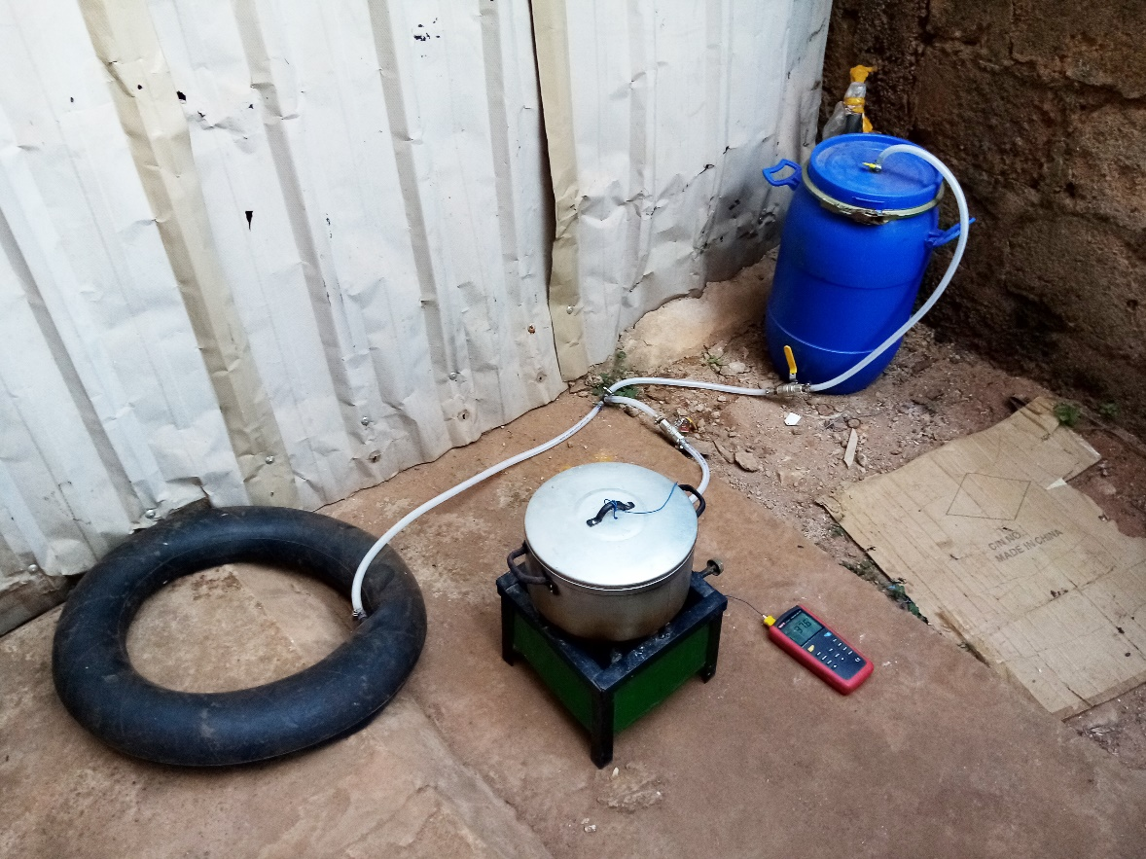
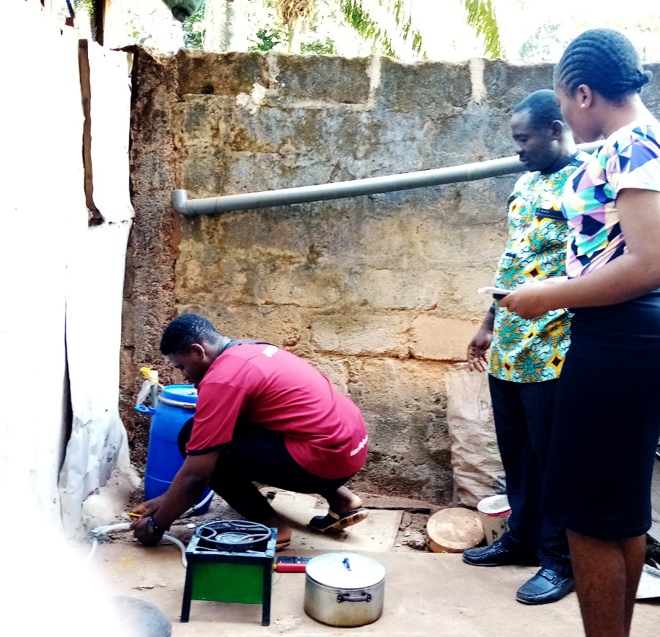
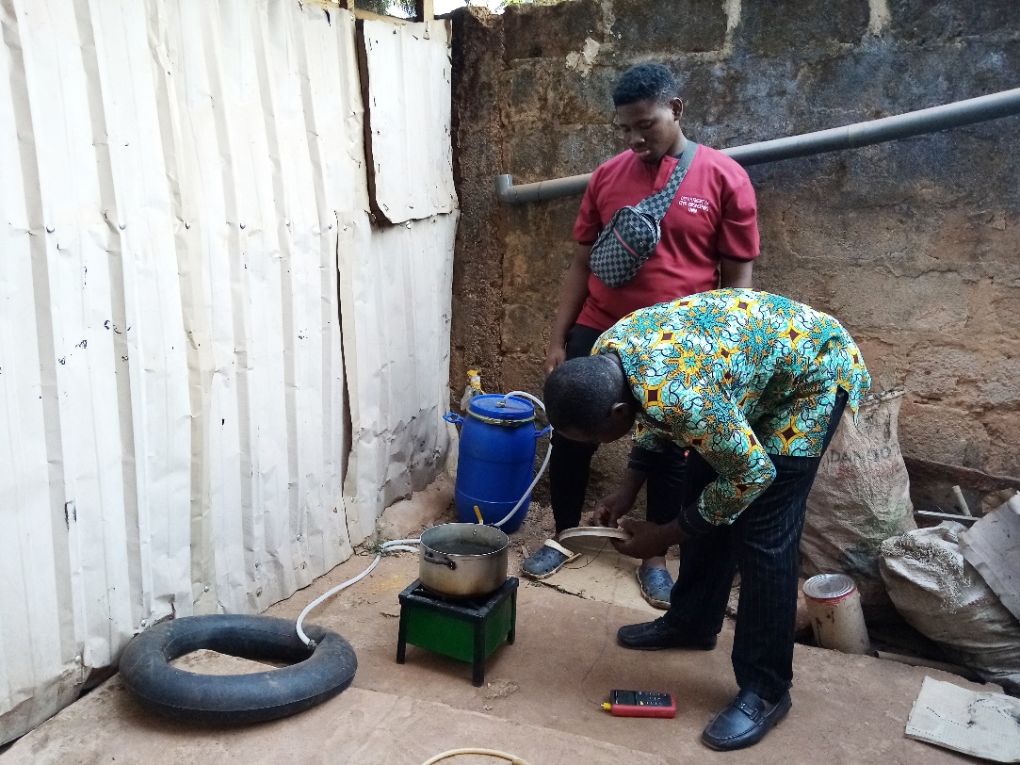
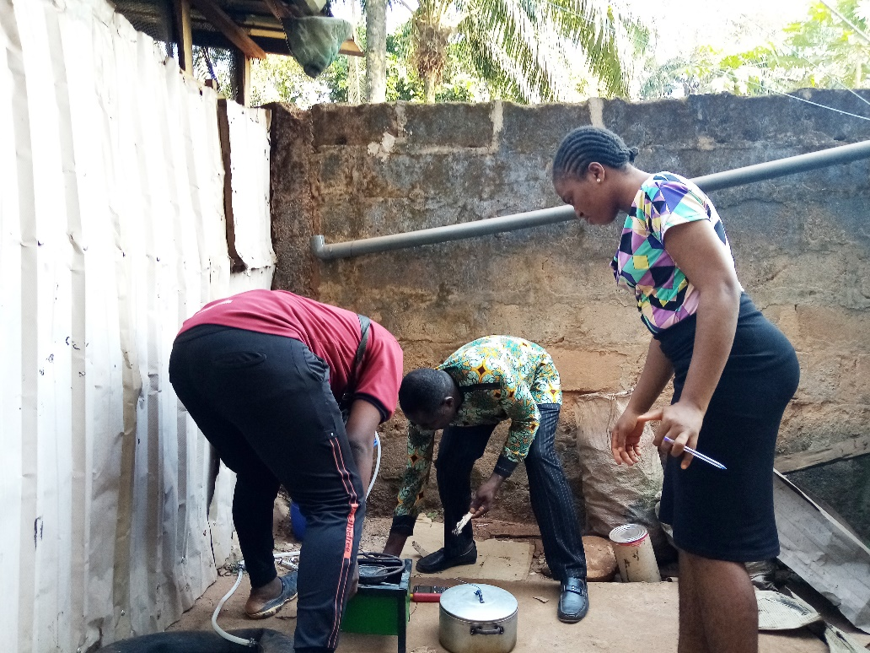
CURRENT PROGRESS IN PICTURES

